Slide 1
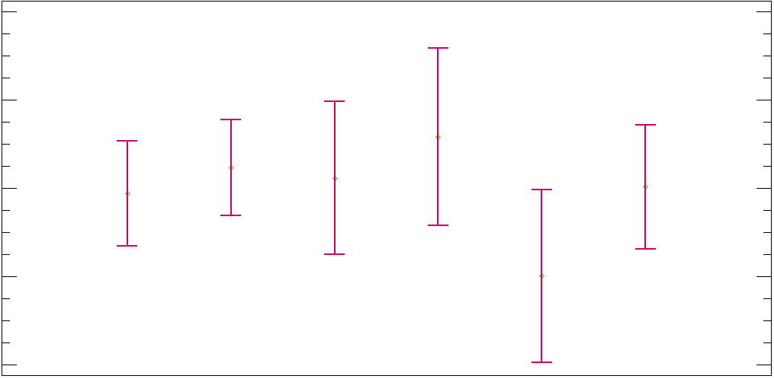
Means & 95% of Fisher´s LSD
18
Unfavorable
16
Favorable
Very
Favorable
YearsCode
14
Indifferent
Unsure
Very
Unfavorable
12
10
Blockchain

